Slide 1

Overview of
Parks Financial Assessment
Parks Forward Commission
December 18, 2013
Notes:
As announced at first meeting, engaged FTI to conduct financial assessment of
Goal of 12-week project was to work in collaboration with Dept management to develop agreed set of facts that would support Commission in its work
Purpose today is summarize key findings in FTI’s report, then give some detail behind findings
First a few caveats – Summarizing 200 pages in 20 mins; while largely complete, still subject to Commission review; FTI’s observations, not Commission’s;
Following presentation, will introduce FTI reps and allow questions from Commission, and have asked Dept will respond to these findings
Summary and full report available on Parks Forward website

Slide 2
Key Observations
Funding
  Operating fund levels stabilized, but bonds almost depleted
  Growing gap between funding and need
Expenditures
  Data issues limiting robust analysis
  Disproportion of HQ expenses/staff versus Field
Maintenance & Infrastructure
  De minimis spend against massive need
  Planning process needs wholesale revamping
Park Revenue
  High concentration of revenue-producing parks
  Few parks cover direct expenses; none cover all-in costs
Partnerships
  Operating partnerships as source of efficiency and innovation
Notes:
F: Primary sources of funding for operations of park system have stabilized over past 4-5 years
But $1 billion of bonds is almost fully spent; If expenses stay the same, funding gap will grow
E: FTI’s analysis was hampered by quality of data and by difficulty accessing the data
One key observation is that HQ spends seems high in relation to the Field
M: Combined short and long term needs of over $3 billion; in FY13, Dept spent less than $35M
FTI and Dept staff uncovered serious deficiencies in Dept’s project’s management process
R: Found high concentration of parks at both ends of revenue spectrum (20 parks produce 60% of revenue; over 100 parks, almost 40%, produce $0)
Handful of parks (mainly state beaches) cover actual direct costs; none cover cost of special projects, overhead, maintenance
P: Looked at various types to determine lessons learned, confirm value
In particular looked at successful operating partnerships created by AB 42, which suggest potential for dramatic park improvement
So let’s dive in. First, some quick basics about Dept’s budget and how it’s funded

Slide 3
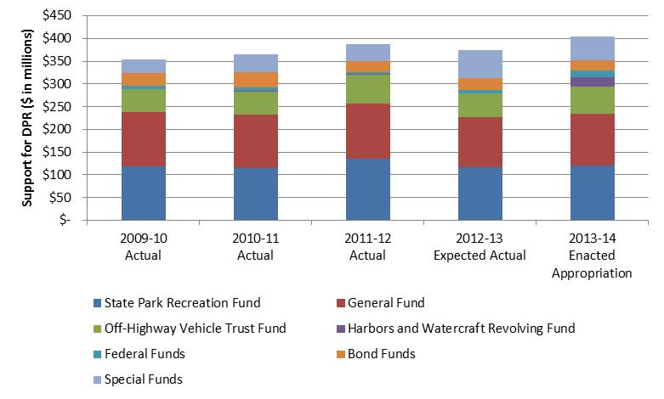
DPR Support – Funding Sources
388
404
355
365
374
Source: FTI Report, p. 40
Notes:
Support for general park operations comes from diverse set of sources
Primary funding sources are General Fund (red) and State Parks and Recreation Fund -- a/k/a “SPRF” (blue), which is funded by park revenue as well as highway and fuel taxes
Other sources include
Off-Highway Vehicle Trust Fund (green)
Bonds (orange)
Various special funds, including revenue from boating gas tax, federal highway dollars for trails, and state sources earmarked for natural resource protection
While there has been some major volatility in past decade, GF and SPRF fairly stable since 2009

Slide 4
Bond Funding
Source: FTI Report, p. 51
Notes:
In recent years, Propositions 84, 40 and 12 have provided major one-time infusions for park improvements in recent years – over $1 billion total
However, these funding sources have been largely drawn down
And they will be exhausted in a few years – roughly $20 million remaining that is not already committed to be spent.
Natural question in era of declining expenditures is how well are funds spent?

Slide 5
Expenditure Analysis – Challenges
Data Issues
  Unreadable or non-digital formats
  Unexplained variances
  Inaccessible data
Process Issues
  Limited expense tracking within year
  Limited detail on type, function, location
  Not all program expenses tracked
Source: FTI Report, pp. 35-36; 59; 63-64
Notes:
Attempting to answer these questions, FTI ran into a significant set of challenging issues relating to how basic financial information is processed and reported by the Dept
PAPER: Key financial reports couldn’t be provided in electronic format or were in corrupted files; FTI had to copy figures manually in order to analyze
VARIANCES: FTI found large variances between expenditure reports and Governor’s Budget -- between $14 - $38.0 million (4% to 12%) that could not be reconciled or explained
ACCESS: Some primary data not easy to find or use because doing so required IT support or depended on single individuals with no trained backups
TRACKING: Dept does not centrally monitor expenditures when cash is disbursed during the year, which makes it very difficult to plan the cash needed to operate. HQ has no reports showing variance to Governor’s Budget or reconciling Dept numbers with it, on annual, let alone monthly basis
DETAIL: To extent tracked done in aggregate, at the division or district level, but not at the park unit level; moreover, expenses aren’t categorized by function
INCOMPLETE: Main reports only track certain programs and did not include all expenditures of the department.
RESULT:
Dept: In light of some of these challenges, many districts track expenditures using their own separate systems to manage their operations; while admirable, doesn’t negate need for centralized rollup
FTI: More than 50% of time spent collecting and formatting rather than analyzing data. Nonetheless, have relied on best available information provided, taken it as accurate except where noted

Slide 6
Support Expenditures – Type & Division
Support Expenditures by Type - FY 2012-13
Personal Services Expenditures by Division - FY 2012-13
$374.4mm
$229.2mm
Source: FTI Report, pp. 65; 67
Notes:
With those sobering challenges as backdrop, let’s look at what CAN be said about expenses using the data that does exist
First, that “personal services” (salaries, wages, and benefits) account for vast majority of expenses.
Second, that if you look at the split of labor expense between HQ and field, field accounts for about 2/3, while Off Highway Motor Vehicle division, overseeing 8 parks, accounts for about 10%.
If you look at staffing levels, they reflect similar proportions to expenses, with close to 30% headcount at HQ

Slide 7
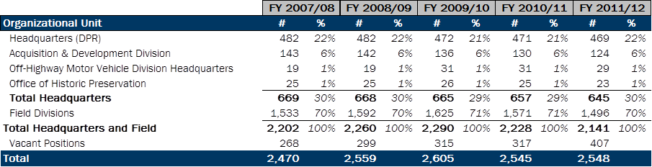
DPR Staffing
Regular/Ongoing FTE Positions
(Excludes Temp)
Source: FTI Report, p. 69
Notes:
Based on some rough benchmarking data collected by FTI, this proportion appears to among the highest relative to other state park systems.
In addition to looking at personnel costs, FTI did a deep dive into maintenance and infrastructure spending

Slide 8
Maintenance & Infrastructure
Current Needs
  Capital Projects: $1.8 billion
  Annual Maintenance: $350 million
  Deferred Maintenance: $1.1 billion
Current Expenditures (2012-13)
  Capital Projects: $24 million
  Annual and Deferred Maintenance: $10 million
} $1.45 billion
Source: FTI Report, p. 101
Notes:
Against this massive need, the current spend is a drop in the bucket
Definition of Unsustainability
In light of the enormity and importance of these amounts, new management team at parks was very interested to have FTI look at the quality of process and data supporting these projects

Slide 9
Deferred Maintenance Review
Identified largest 50 projects, representing over $200 million of $1.1 billion
Chose 5 to test project cost estimates
  Total projected cost: $23.2 million
  2 projects ($7.6 million total): no data found
  3 other projects ($15.7 million): cost estimates were 1.7x, 2.1x and 10x appropriate amounts
  Revised cost of 5 projects: $6.2 million
Source: FTI Report, pp. 110-11
Notes:
FTI reviewed Dept’s deferred maintenance database and identified top 50 projects (in terms of estimated cost).
From this group of 50 projects, FTI’s team of inhouse construction experts selected five projects across several categories, including road repair, wastewater replacement and general construction. They reviewed these projects to determine if estimated costs in the deferred maintenance database were appropriate.
For 2: Dept staff could not locate any specifications or documentation for projects
For other 3, found significantly over-estimated costs by amounts shown; total revised costs downward by $15M
What is upshot? Costs are likely materially overstated across all databases. Little oversight, inconsistency in estimation metrics, no updating of costs; clear, field is not effectively using the current database as a tool for assessing spending priorities.
[Q/A: Over or under stated?]
(i) materially understated -- due to the enormity of the already catalogued backlog, some field operators have ceased routinely updating the database with new line items (projects) for frustration that projects will “never be funded”; or
(ii) materially overstated -- with respect to the line items that are presently in the database, estimates could be inaccurate due to duplicate or overlapping entries, outdated technology initially considered in developing the estimated, etc.
Either way, fixing it solves the problem – breaking this cycle is critical to give both internal and external (e.g., state authorities, potential partners, general public) confidence that the overall capital needs of the Dept are accurately captured.

Slide 10
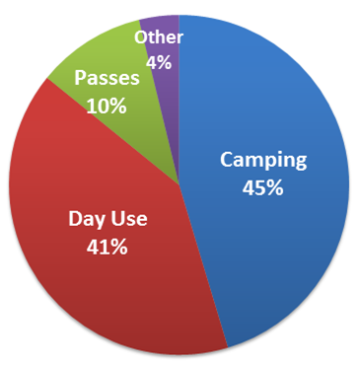
Park Revenue Mix
Revenue by Source
FY 2012-13
User Fees by Type
FY 2012-13
$107.9mm
$91.8mm
Note: Excludes OHMVR park revenue ($5mm) and registration fees ($17mm) , as well as miscellaneous income ($0.9mm)
Source: FTI Report, pp. 89; 94
Notes:
Park revenue can be broken into -- user fees, concessions and miscellaneous revenue.
Just looking at user fees -- $91.8 million in user fees, you can see that primarily come from camping fees and day use (entry and parking) – 86%

Slide 11
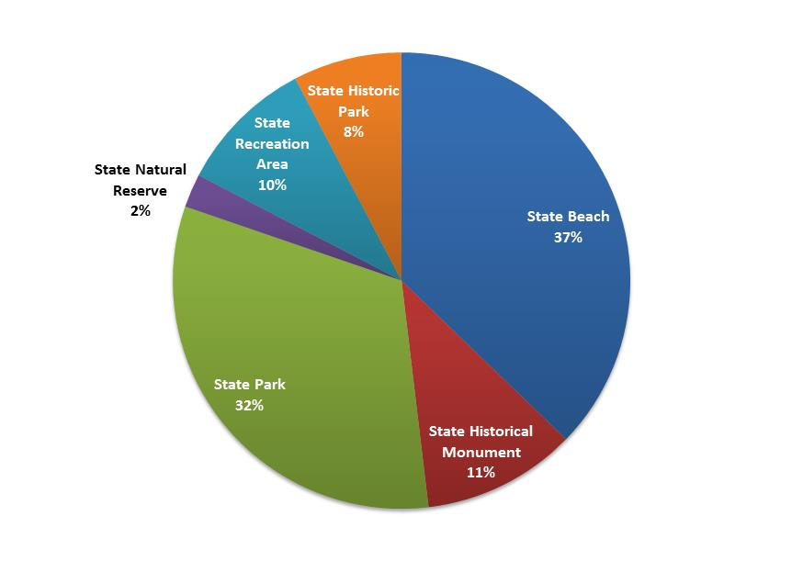
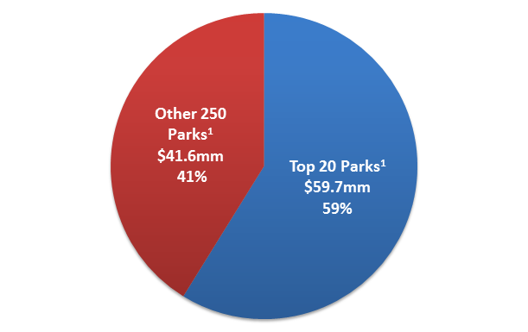
Park Revenue Concentration
Park Revenue Share
FY 2012-13
Revenue by Park Class
FY 2012-13
$101.3mm
$101.3mm
Note: Charts exclude income booked at division/district/sector level ($6.6mm)
Source: FTI Report, pp. 92; 96
Notes:
Top 20 parks, contributed almost 60% of revenue in FY 2012/13, which demonstrates a high degree of revenue concentration.
The top revenue generating park in FY 2012/13 was Hearst Castle. It earned over $11 million, or 11%, of total park unit revenue.
About 39% of parks contribute no revenue to the Dept

Slide 12
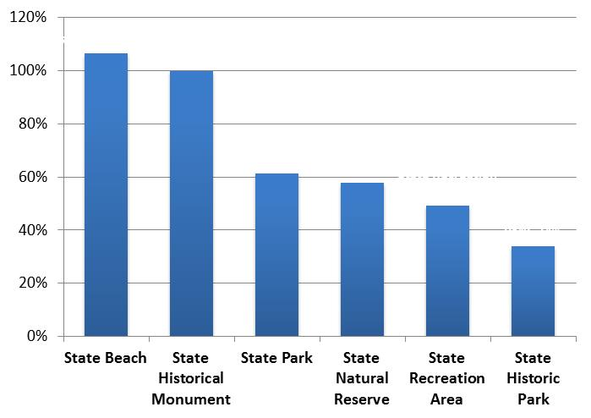
Park Unit Cost Recovery
Note: Calculations based on FY 2012-13 revenue
Source: FTI Report, pp. 95-6
Notes:
One measure of park’s financial performance is whether it generates enough revenue to cover costs
FTI looked at what percentage of park’s direct operating costs are recovered from its revenue.
State beaches with camping represents the only group of parks which generates revenue that meaningfully exceeds estimated park operating costs.
Most parks are able to cover only a portion of their direct estimated direct park operating expenses and none of their costs for special projects, headquarters or deferred maintenance.

Slide 13
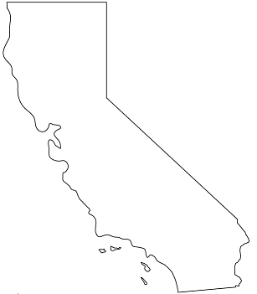
Partnership Review
Jedediah Smith Redwoods SP
Legend:
National Park Service
American Land & Leisure
East Bay Regional Park District
Valley of the Moon Natural History Association
Anza-Borrego Foundation
City Park of San Francisco
Major city
Del Norte Coast Redwoods SP
Prairie Creek Redwoods SP
Woodson Bridge SRA
Sacramento
McLaughlin Eastshore SP
Jack London SHP
Brannan Island SRA
Robert W. Crown Memorial SB
Mount Diablo SP
San Francisco
Turlock Lake SRA
Lake del Valle SRA
Candlestick Point SRA
Santa Barbara
Los Angeles
Anza-Borrego Desert SP
San Diego
Source: FTI Report, p. 119
Notes:
FTI evaluated five different partnership agreements, as well as parking lot concessionaire agreement, with the goal of evaluating what is working, what isn’t, and -- where possible -- the financial impact of these agreements.
Goal was look at various types of partners and agreement structures:
National Park – interagency agreement
American Land & Leisure – for-profit concession agreement
EBRPD – special district operating agreement
Valley of the Moon Natural History Assoc. – non-profit operating agreement
Anza-Borrego Foundation – non-profit cooperative association
City Park of SF – for-profit concession agreement

Slide 14
Partnerships – Takeaways
Key Contributions Across All Partnership Models
AB 42 Operating Partnerships
  Jack London – tripled revenue, halved deficit, grew visitors and special events
Nonprofit Partners
  Cultural and historical fit
  Fund-raising and friend-raising
  Re-investment in park
For-Profit Partners
  Outperformance required versus other options
  Special skills, scale, capital
Source: FTI Report, p. 113-15
Notes:
Jack London
As of October 2013, there were four operating agreements with nonprofits made possible by AB 42 (Jack London State Historic Park, Austin Creek State Recreation Area, Sugarloaf Ridge State Park, China Camp State Park).
Nonprofits can used to supplement services like Anza Borrego and to operate parks like Jack London. Maybe untapped opportunity for state historical parks, which can attract donations, volunteers and community involvement, as well as special events.
For-profits must be materially more efficient in revenue generation and/or cost reduction vs. nonprofit partners to offset the income they necessarily capture via their operating agreements.
The DPR should consider larger, for-profit partners who potentially have greater buying power, management flexibility and access to capital to drive these efficiencies.

Slide 15
FTI Recommendations
  Measure and Manage Costs
    Establish data and process integrity
    Track and report expenses by function at unit level
    Zero-base infrastructure and maintenance projects
  Accelerate Revenue Growth
    Identify most growable revenue sources
    Develop cost-recovery mindset
    Stay true to DPR mission and expand access
  Expand Partnerships
    Base on DPR need, park and partner characteristics
    Leverage nonprofits, esp in historic parks
    Develop partner management expertise
  Identify Stable Funding
    No solution without sustained public funding
Source: FTI Report, pp. 7-9; 29-31; 56-59; 78-80; 99-100; 113-15
Notes:
Focus of FTI not on specific, detailed recs, but agreed baseline of facts. Nontheless….
COSTS:
Data Integrity:
Improvements in data quality are foundation for restoring Dept’s credibility and culture
Need basic modern tools and process: Better reporting including – for starters – monthly reconciliation of cash expenditures and reconciling with the Governor’s budget
Park Unit:
Develop models for determining what SHOULD be incurred in FUTURE to operate parks, based on different service levels and for different types of parks
Dept must create benchmarks across park systems, that comparison of costs across different factors such as park size, location, the primary Dept mission it serves (recreation, cultural) and the types of activities support that purpose
Maint/Infra:
Dept should adopt zero-based approach to both infrastructure and maintenance databases, coupled with revised process for entering projects and estimated costs using external subject matter experts
Zero-base means “start from scratch” – projects won’t appear in database, won’t get approved, unless new process followed
REVENUE:
Focus where the revenue is most growable
Cost recovery mindset
Always with mission in mind and need for maintaining public access
PARTNERS:
FTI recommends fully embracing partnerships as central component of Dept’s operations
Long-standing partnerships between agencies demonstrate potential; newer partnerships like Sonoma parks AB 42 operating partnerships suggest even more innovations on horizon
Identify parks or groups of parks most suitable, types of potential partners and agreements
Two key steps are institutionalizing partner management skills in Dept, and creating centralized database of contracts and partnership know-how
Training needed for both Dept and its partners – regarding each party’s scope of responsibility, removing roadblocks to decision-making, and defining processes for escalating disputes, resolving conflicting duties
Fourth recommendation – in light of funding challenges, required ongoing subsidy, must find stable funding mechanism

