Slide 1
Overview of State Parks Staff
Outreach and Public Workshops
Parks Forward Commission
December 18, 2013

Slide 2
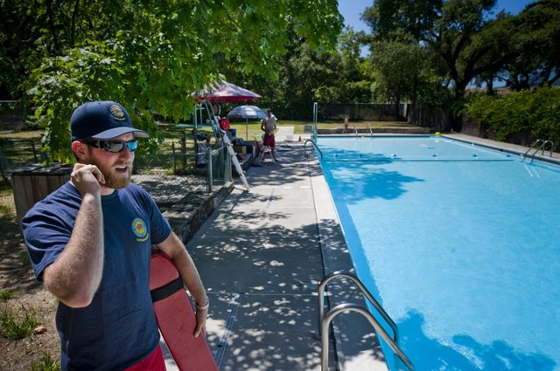
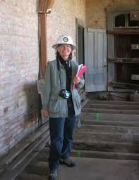
Staff Survey
Created by Parks Forward
and State Parks staff
Sent to 2500 employees
Anonymous responses
Purpose
Understand issues important to staff
Surface concerns about Parks Forward
Solicit ideas for moving forward

Slide 3
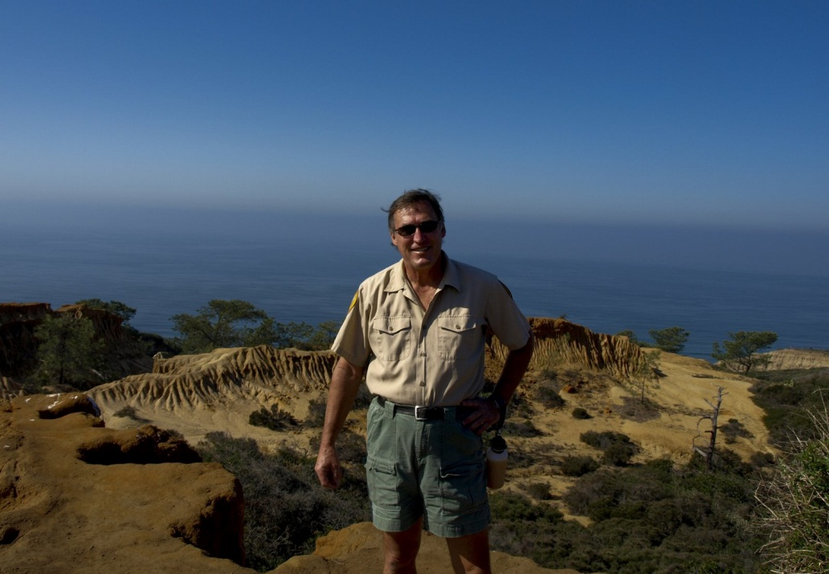
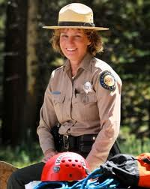
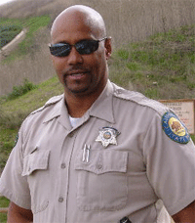
Staff Survey Results - Overview
Public safety and recreation functions are performed well
Maintenance functions require improvement
Protecting valued natural resources considered highest priority

Slide 4
Staff Survey Results - Finance
Need clearer connection between operational needs and allocation of funds
Top opportunities for reducing costs
Reduce upper management
Improve accounting systems
Improve procedures and processes
Top opportunities for increasing revenue
More special events and new attractions and services
Marketing

Slide 5
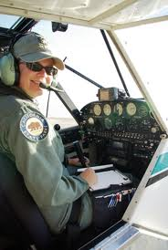
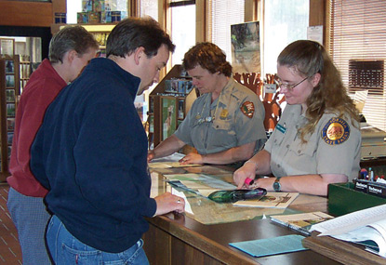
Staff Survey Results - Personnel
Leadership development and training
Promotional testing
Improve communication
Hire more qualified people

Slide 6
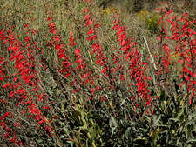
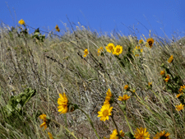
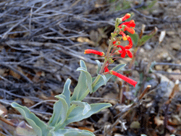
Staff Focus Groups
Seven focus group sessions in August 2013
Over 140 staff participated
Rank-and-file staff, managers and supervisors, and superintendents
Purpose
Share vision for stronger future for State Parks
Discuss role of Parks Forward Initiative

Slide 7
Staff Focus Groups – Common Themes
Lack of adequate funding
Improvements needed for budgeting and allocation of existing funds
Lack of effective communication between headquarters and regions
Need to restore public trust and improve employee morale

Slide 8
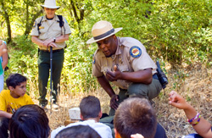
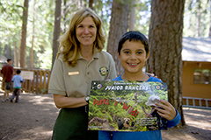
Staff Focus Groups – Common Themes
Cumbersome and inefficient policies and processes
Frustration with promotion policy; broader opportunities needed
Key asset is employees’ continued passion for State Parks and its mission

Slide 9
Public Workshops
Ten public workshops
Statewide
September through October 2013
Purpose: Solicit input and ideas from the public on the future of State Parks
Attended by over 400 members of the public

Slide 10
Public Workshops – Organizing Themes
Meeting the needs of all Californians
Sustainable funding
Partnerships

Slide 11
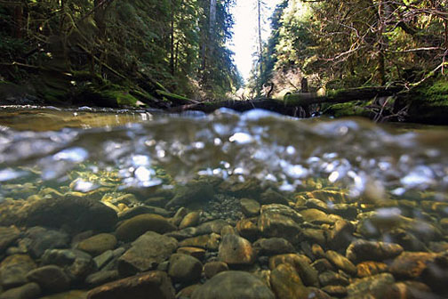
Public Workshops - Input
Need a diverse mix of funding sources including dependable state funding
Effective partnerships can play a key role
Long-term success requires improving park access to California’s changing population
No “one-size-fits-all” solutions

Slide 12
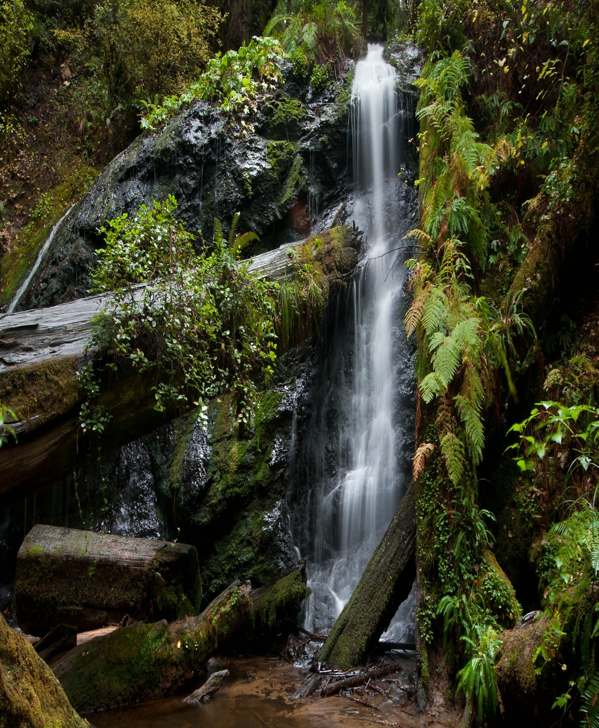
Public Workshops - Input
Opportunities exist to increase visitation
Importance of relationships with local communities
Need to improve marketing and outreach
Improved planning and management will rebuild public trust

Slide 13
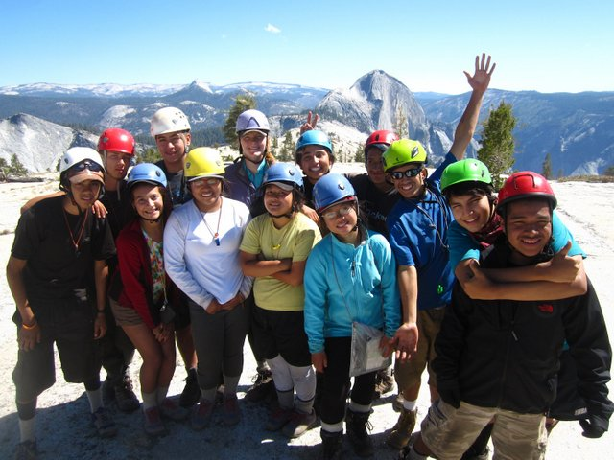
End – photo only

